Slide 1
CIS8695 Managing Big Data Analytics
Nasim Mousavi
Assistant Professor
J. Mack Robinson College of Business
Georgia State University
nmousavi@gsu.edu

Slide 2
What is Data Science?

Slide 3
Data Science
All about managing big data, extracting managerial insights from it
A multidisciplinary field combining skills in computer science and statistics with domain expertise to support the analysis of large and diverse data sets
As a data scientist you uncover values for an organization and then communicate them to stakeholders as actionable results

Slide 4
Why Data Science Is Trending? Big Data
These days, more data is generated than ever
New data is generated faster than ever
Improvements in computing power and capacity
Progress in algorithms & software tools
All of these create valuable applications, including:
Product recommendations
Marketing analysis
Demand forecasting
Fraud detection

Slide 5
Definition of Big Data: 4Vs
Big data is usually characterized by four Vs
Volume
Variety
Velocity
Veracity

Slide 6
Volume: Amount of data
These days data has high volume:
Transaction-based data stored through the years
Unstructured data streaming in from social media or smartphone, etc.
Sensor and machine-to-machine data being collected (e.g, IoT)

Slide 7
Variety: Different Types of Data
Data today comes in all types of formats
Structured, numeric data in traditional databases
Information created from line-of-business applications
Unstructured text documents, email, video, audio, stock ticker data and financial transactions
Managing, merging and governing different varieties of data is very complex

Slide 8
Velocity: The Speed of Data Generation
Data is streaming in at unprecedented speed and must be dealt with in a timely manner
To be useful, we need to deal with this large amount of data in near-real time
Reacting quickly enough to deal with data velocity is a big challenge

Slide 9
Veracity: Variability in Data Content
Data flows can be highly inconsistent with periodic peaks
Is something trending in social media?
Daily, seasonal and event-triggered peak data loads can be challenging to manage

Slide 10
Data Science Project Life Cycle

Slide 11

Data Science Project Life Cycle
A typical data science project should follow these steps

Slide 12
Data Analysis Steps:
1. Define Purpose

Slide 13
Define Purpose
The process begins by developing an understanding of the purpose of the project
How will the organization use the results?
Who will be affected by the results?
Will the analysis be a one-shot effort or an ongoing procedure?

Slide 14
Data Analysis Steps:
2. Obtain & Prepare Data

Slide 15
Obtain Data
Involves sampling from a large database to capture records to be used in an analysis
How well this sample reflects the records of interests to ensure the generalizability of the results

Slide 16
Data Preparation
The first step in a data preparation step is often “Getting to know the data”
Descriptive statistics provide a framework for this
Plot data to quickly identify trends and features
Calculate numerical values that characterize the data
To answer:
What types of variables does this data have?
How do the variables relate to each other?
What is a usual value for each variable?
How are variables distributed?
What is the relationship between different variables?

Slide 17
Dependent & Independent Variables
In building a statistical model, there are two main variables to consider
Dependent: The output result we’re interested in measuring
Independent: Input parameter(s) we’re testing for its effect on output
You must account for covariates
These are input parameters that might also affect result
They aren’t tested, but must be controlled as far as possible to avoid interference

Slide 18
2.1. Outlier Detection

Slide 19
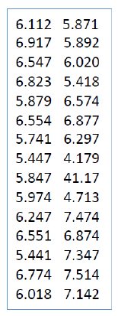
Outlier Detection
An important step in data processing
Data may contain “bugs” just as software does
These can be difficult to find and may lead to bias results & invalid conclusions
Looking at a set of numbers hardly ever uncovers the problem

Slide 20
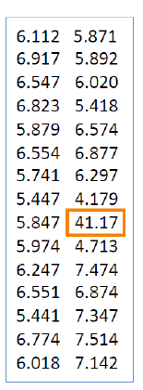
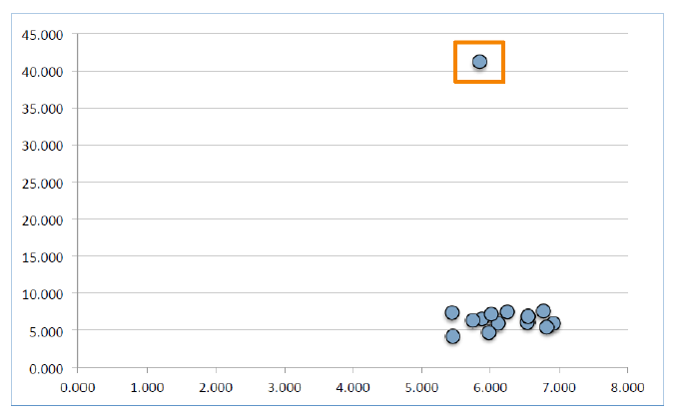
Outlier Detection
Scatterplots help to expose potentially invalid data
The latent problem in this data set is obvious when visualized
Outliers are usually removed from the dataset

Slide 21
2.2. Handling Missing Values

Slide 22
Missing Values
If the number of records with missing values is small, they can be omitted
Otherwise, we might miss important information by omitting them
We can replace the missing values with imputed ones
Using mean, median, etc.
Using regression models

Slide 23
2.3. Dimension Reduction

Slide 24
Dimension Reduction
Sometimes the dimension of dataset, number of variables is huge
And must be reduced for algorithm efficiency, accuracy and reliability:
Multicollinearity: multiple correlated variables
Overfitting (building a model that exactly describes the data)
Such a model most likely describes noise, and is said to be overfit
Low generalizability

Slide 25
Dimension Reduction Techniques
Incorporating domain knowledge to remove or combine categories
Using data summaries to detect correlated variables(remove or combine redundant variables)
Employing automated reduction techniques, like PCA
A new set of variable is created that are weighted average of the original variables
Using methods, such as regression models, classification methods, like decision tree

Slide 26
Data Analysis Steps:
3. Model Selection

Slide 27
Types of Data Analytics
Descriptive: “What has happened?”
Query/drill down: What exactly is happening?
Ad hoc reports: How many, how often, where?
Standard reports
Predictive: “What could happen?”
Prescriptive: “What’s the best outcome given our descriptive and predictive analytics?”

Slide 28
Predictive Analytics
Problem types
Classification/Prediction
Pattern recognition
Techniques
Regression (e.g., linear, logistic)
Classification (decision trees, random forest, support vector machines, etc.)
Clustering (e.g., k-means, hierarchical)
Association rules & Recommendation Systems
Conventional neural networks
Text classification and topic modeling

Slide 29
Supervised vs. Unsupervised Learning
Supervised learning: Predicting the outcome variable for new records
Outcome of interest is known, “labeled data”
Training data: from which the model/algorithm “learns”
Validation data: where the trained model is applied to for assessment of performance, and model comparison
Test data: if model selection is involved, test data is used to assess the finally selected model
The outcome in the test data is also known

Slide 30
Supervised vs. Unsupervised Learning
Unsupervised learning
No outcome to be classified or predicted
Let the data tells the story (patterns) by itself, and no predetermined patterns to be learned from training data

Slide 31
Data Analysis Steps:
4. Model Evaluation

Slide 32
Evaluating Predictive Performance
Partition data into three categories:
Training: The largest partition to build/train models
Validation: Assess the predictive performance of models and select the best one
Test (holdout, evaluation): Assess the performance of the selected model with new data

Slide 33
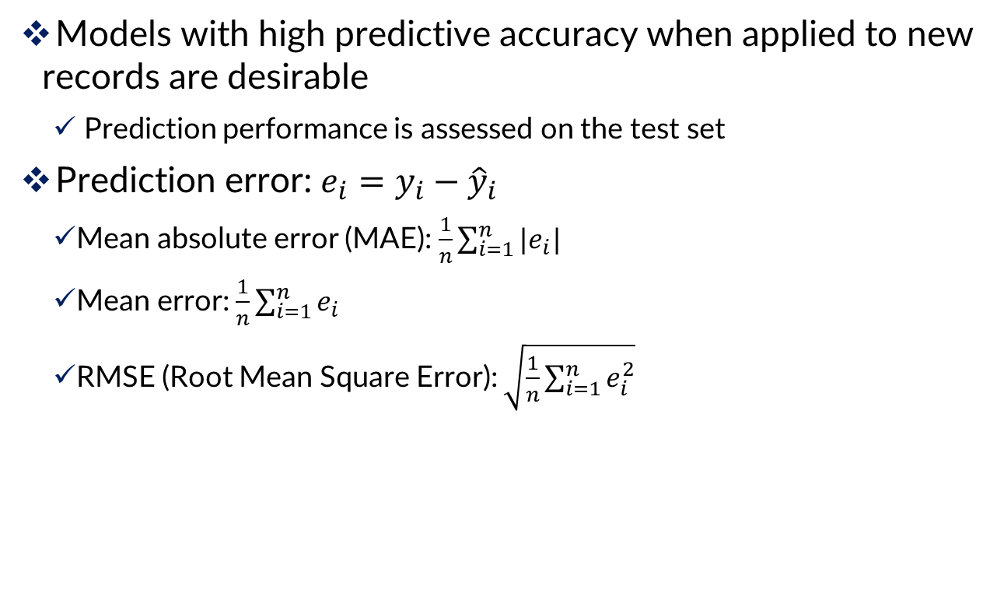
Evaluating Predictive Performance
Models with high predictive accuracy when applied to new records are desirable
Prediction performance is assessed on the test set
Prediction error: $e_{i}=y_{i}−{\hat{y}}_{i}$
Mean absolute error (MAE): $\frac{1}{n}\sum_{i=1}^{n}{|e_{i}|}$
Mean error: $\frac{1}{n}\sum_{i=1}^{n}{e_{i}}$
RMSE (Root Mean Square Error): $\sqrt{\frac{1}{n}\sum_{i=1}^{n}{e_{i}^{2}}}$

Slide 34
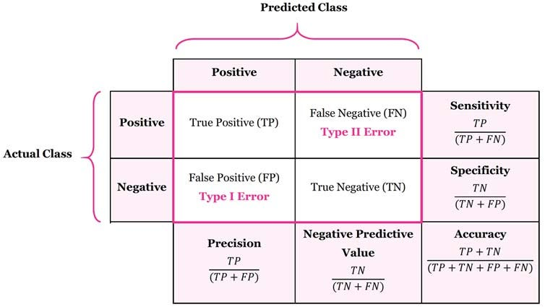
Judging Classifier Performance
Confusion matrix:
Summarizes the correct and incorrect classifications by a classifier

Slide 35
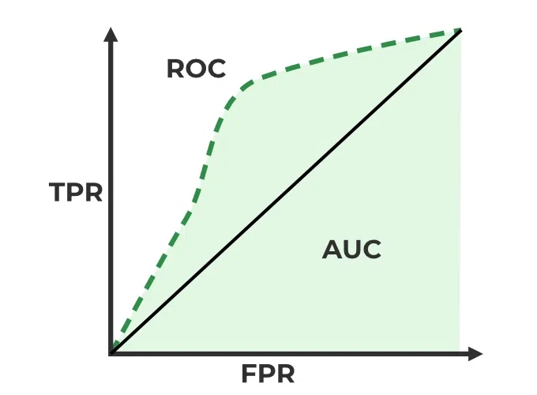
Judging Classifier Performance
ROC (Receiver Operating Characteristics)
The effectiveness of the binary classification model
Plots the true positive rate (TPR) vs. the false positive rate (FPR) at different classification thresholds.
AUC (Area Under the Curve)

Slide 36
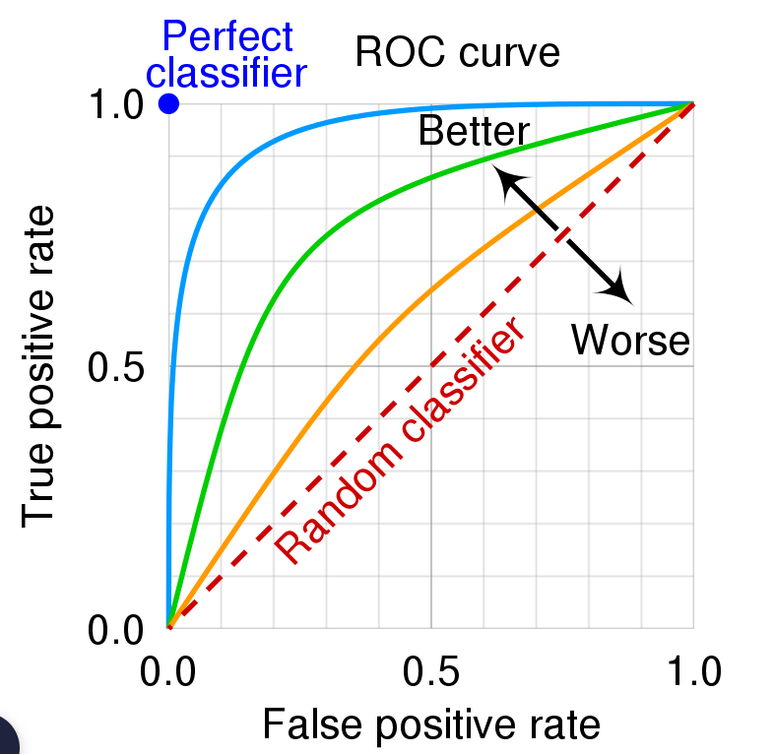
Judging Classifier Performance
A greater value of AUC denotes better model performance
Our main goal is to maximize this area in order to have the highest TPR and lowest FPR at the given threshold

Slide 37
Data Analysis Steps:
4. Deployment

Slide 38
Deploy the Model
This step involves integrating the model into operational systems and running it on real records to produce decisions or actions

Slide 39
